Slide 1
ENGI 301 2- Player Pattern Memory Game Proposal
13th February 2023
Deepak Narayan

Slide 2
Background Information: My Story
One player sets a pattern using a keypad; the other is briefly shown the pattern and then attempts to replicate it correctly
Turning the standard memory pattern game into a 2-player game seemed like a good project to get started in learning to make a game
I am also interested in learning about multiplexing and Charlieplexing. I hope to learn a lot about how LED matrices work through this project.

Slide 3
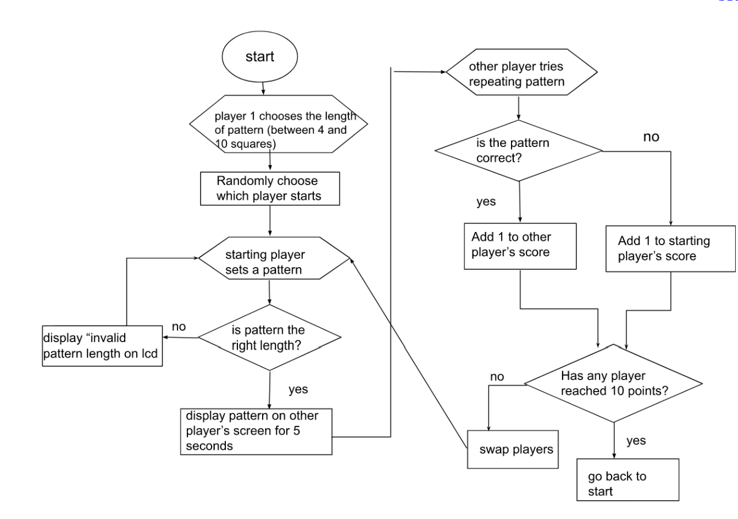
Background Information: Overview of the Game
Figure 1: Game Logic Flowchart

Slide 4
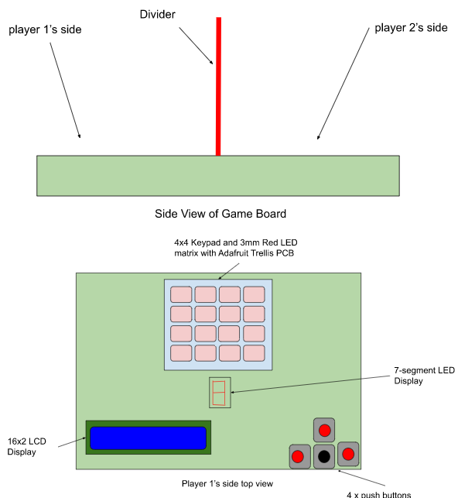
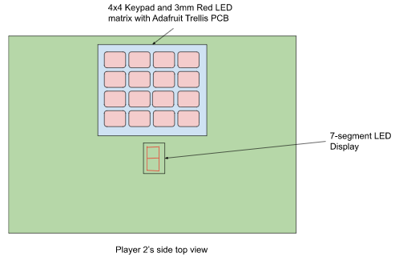
Background Information: The Device
Figure 3: Top view of player 2’s side
Figure 2: Side view of game board (top) and top view of Player 1’s side(bottom)

Slide 5
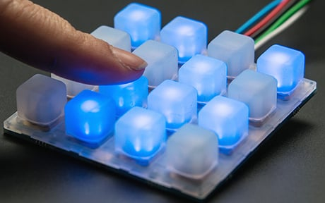
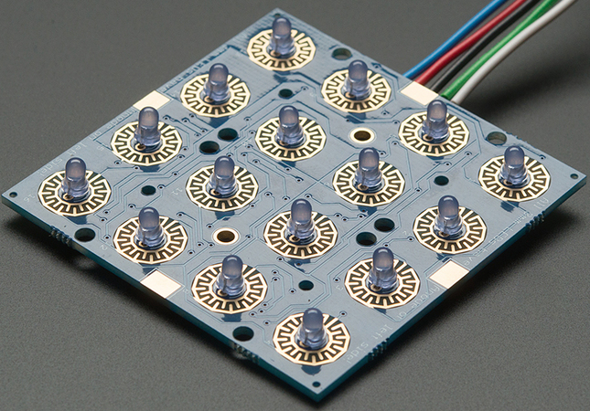
Background Information: The Device
Player 1 interfaces with LCD with the pushbuttons to select the pattern length
Players’ Score is shown on 7-segment LED
Figure 4: Adafruit Trellis PCB with LEDs installed (Rembor) [1]
Figure 5: Adafruit Trellis PCB with LEDs and 4x4 keypad (Rembor) [2]
[1]: Rembor, Kattni “Adding LEDs” Adafruit, 6 Dec. 2013, https://learn.adafruit.com/adafruit-trellis-diy-open-source-led-keypad/adding-leds Accessed 12 Feb. 2023.
[2]: Rembor, Kattni “Overview” Adafruit, 6 Dec. 2013, https://learn.adafruit.com/adafruit-trellis-diy-open-source-led-keypad/overview Accessed 12 Feb. 2023

Slide 6
Background Information: Existing Project and Improvements
My project is based on a Pattern Memory Game with the Tessel 1 Development Board:
https://www.hackster.io/nmoadev/rebloc-099bdd
https://github.com/nmoadev/reBloc/blob/master/rebloc.js
My project adds multiplayer and the option to choose the size of the pattern.
Additional software: code to store patterns, validate patterns, swap players, and count score
Additional hardware: 16x2 LCD display, push buttons, 7-segment LED Display

Slide 7
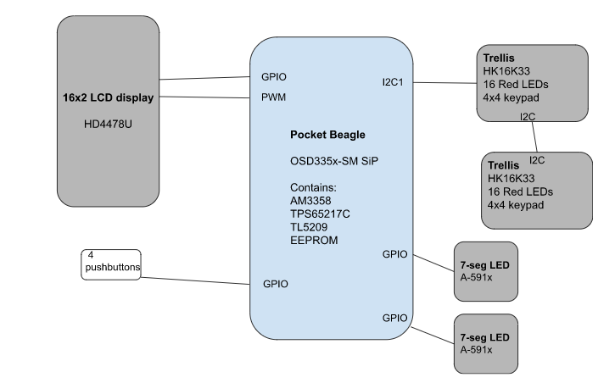
System Block Diagram
Figure 5: System block diagram for the game

Slide 8
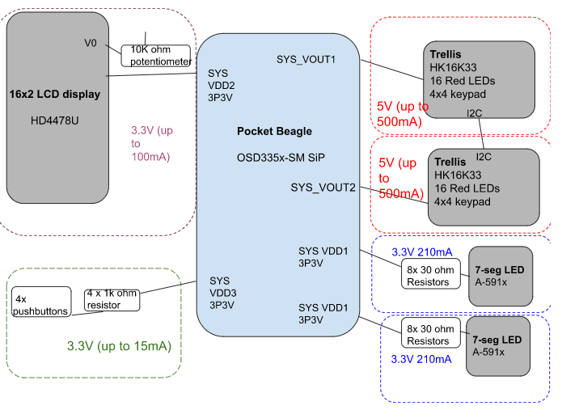
Power Block Diagram
The datasheet for the Trellis does not specify an exact value for the current draw. An additional power source might be needed.
Figure 6: Power Block Diagram of Game

Slide 9
Components / Budget
Component | Need to Buy | Total
Adafruit Trellis Driver PCB | 2 | $19.90
Trellis Elastomer Keypad | 2 | $9.90
Standard LCD 16x2 + extras | 1 | $9.95
USB power supply | 1 | $11.89
7-Segment LED Display | 1 | $10.95
I can source the 7-seg LEDs, buttons, and Red LEDs myself and from the parts kit
An additional power source may be needed after the current draw of the Trellis is measured

